Slide 1




Centre for Technology Alternatives for Rural Areas
Indian Institute of Technology Bombay
Big Data tools for monitoring the impact of
MGNREGS-IWMP projects
Examiners Prof. N.C. Narayanan Prof. Satish B. Agnihotri Prof. Raaj Ramsankaran
Guided by,
Prof. Pennan Chinnasamy
Presented by,
Shivanand Nalgire (193350009)

Slide 2


Content
Introduction
MGNREGS-IWMP
Need for study
Project formulation
Objectives
Study area
Methodology
RSEI framework
Model development
Analysis
Comparative analysis of CAG audit and RSEI
Impact assessment on applied vs. controlled site
Results and discussions
Conclusion
Limitations and future direction

Slide 3


About MGNREGS-IWMP
Introduction
Project formulation
Analysis
Results and discussions
Methodology
Mahatma Gandhi National Rural Employment Guarantee Scheme (MGNEGS)
Rs.73,000 crores for year 2021-22
78% resources – NRM component
59% resources – water conservation and water security
Integrated Watershed Management Program (IWMP)
Watershed Development Component of PMKSY (2015)
Watershed approach for NRM and water conservation
Convergence with MGNREGS

Slide 4
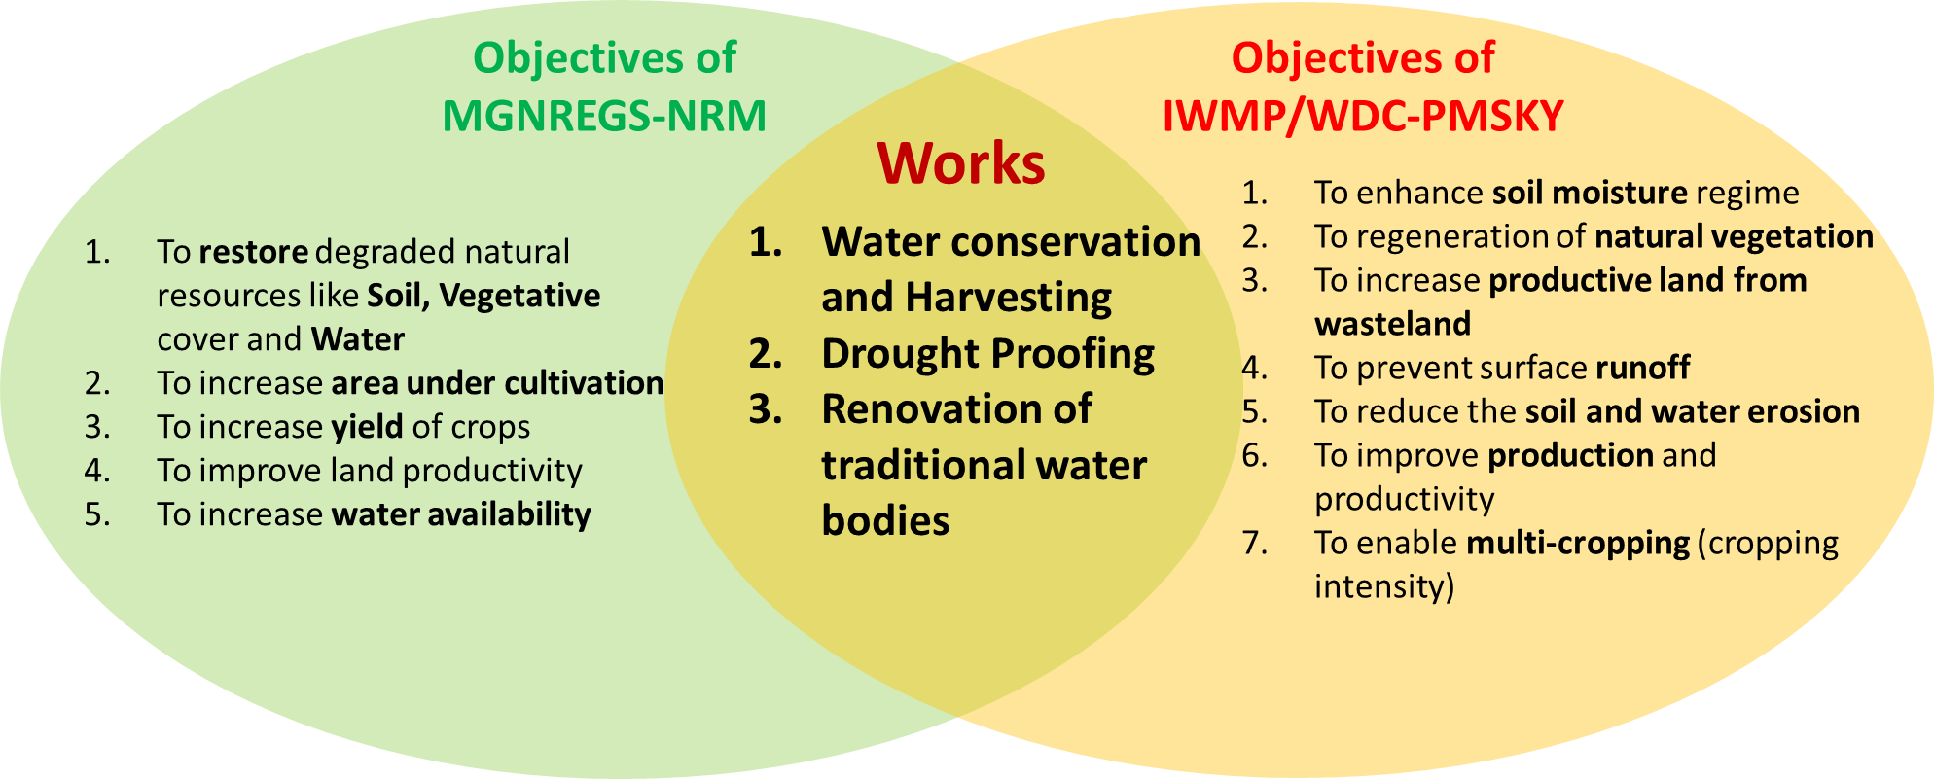
Convergence of MGNREGS-IWMP
Introduction
Project formulation
Analysis
Results and discussions
Methodology

Slide 5
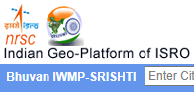


Need for monitoring the project impacts
Introduction
Project formulation
Analysis
Results and discussions
Methodology
Most of the monitoring inclined towards –Fund utilization, employment generation, and work completion
Mapping assets/projects
But little monitoring of post implementation impact of assets
39th and 49th standing committee reports of MoRD mandates the development of quick, low-cost M&E framework
With 1% of total project cost for impact assessment

Slide 6


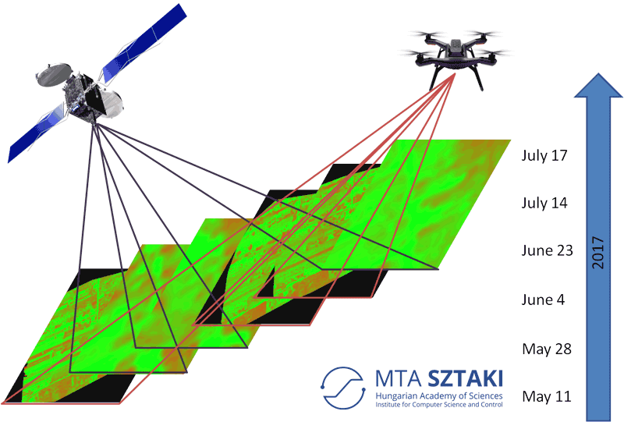
About project
Introduction
Project formulation
Analysis
Results and discussions
Methodology
Developing Monitoring and Evaluation (M&E) framework
Assessing the impact of MGNREGS-IWMP projects
Using open source remote sensing Big Data
What study is doing?
For what?
How?

Slide 7
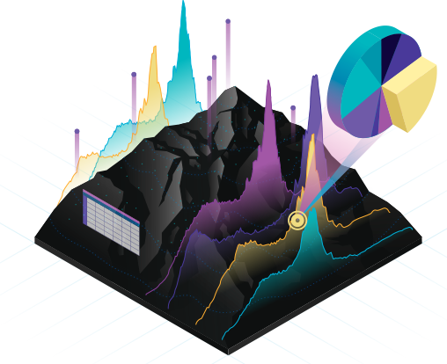

Objectives
Introduction
Project formulation
Analysis
Results and discussions
Methodology
To identify the remote sensing indices representing the natural resource attributes like vegetation, soil, and water
To develop an index based multi-dimensional M&E framework to determine the ecological status of land surfaces
To analyze the impacts of MGNREGS-IWMP projects using index based M&E framework based RS data

Slide 8
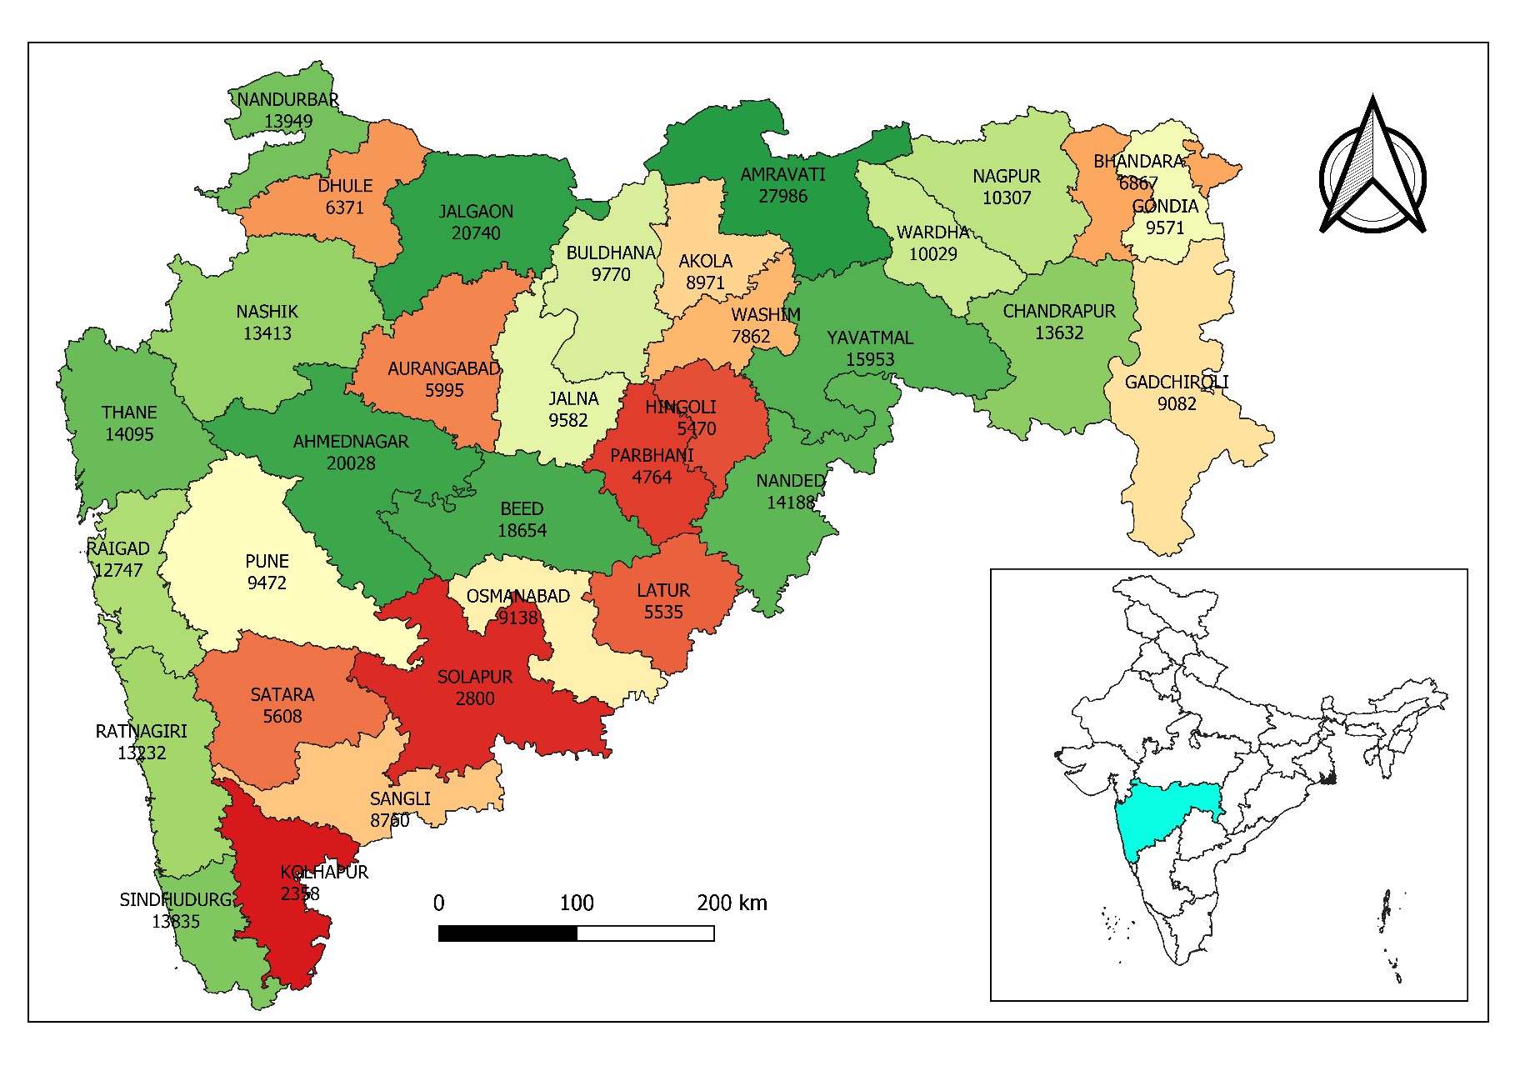
Study area
Introduction
Project formulation
Analysis
Results and discussions
Methodology
Highest (242 out of 1344) number of IWMP Watersheds are in Maharashtra
Study M&E for three categories of works under MGNREGS –
Water conservation
Renovation of traditional water bodies
Drought proofing
Ahmednagar district has highest expenditure of Rs.27,000 crores under these 3 categories (2007-20) and was audited by CAG in 2020 (Jalyukta shivar)

Slide 9
Ecological status of land surfaces
Introduction
Project formulation
Analysis
Results and discussions
Methodology
Termed as Ecological Status of Land Surfaces (Kennedy et al., 2009; Xu et al., 2019)
Assessed by Ecological Monitoring of Land Surfaces (Willis, 2015)
Using Land Surface Ecological Indicators (Jones et al., 2009)
MGNREGS(NRM)-IWMP
Enhance soil moisture regime
Regenerate natural vegetation
Increase productive land, production and productivity

Slide 10
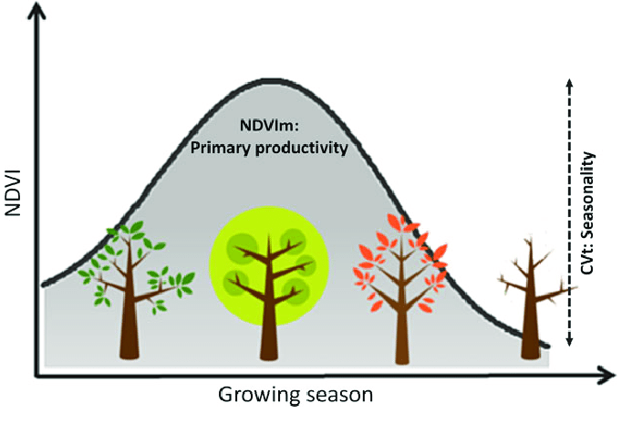
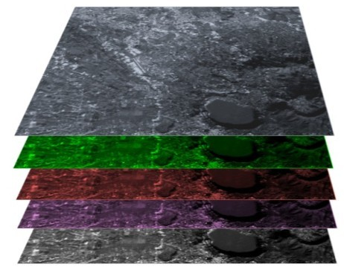
Remote Sensing for monitoring Ecological Status
Introduction
Project formulation
Analysis
Results and discussions
Methodology
RS and GIS – monitor natural resources at multi-temporal, multi-spectral, and multi-spatial resolution
Open source, high resolution RS data detect components of earth surfaces – vegetation, soil moisture, surface temperature
Algorithms and composite indices
Oriented to specific ecologically related theme (e.g. NDVI)
Aggregated RS index – with 2 or more metrics
Reveals comprehensive ecological status
Quick, effective detection, and quantification of ecological changes

Slide 11
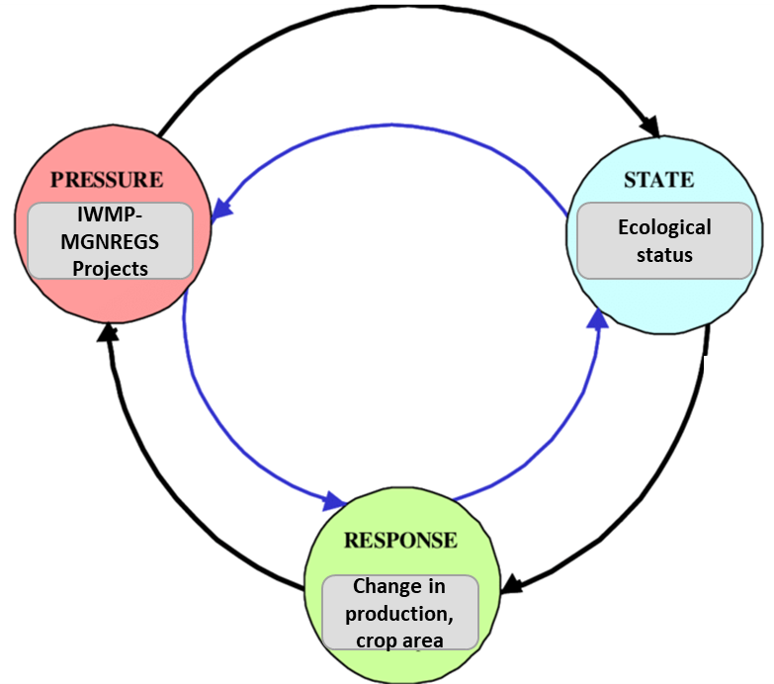
Remote Sensing based Ecological Index (RSEI)
Introduction
Project formulation
Analysis
Results and discussions
Methodology
Based on System Dynamics concept – Pressure State Response framework (Friend and Rapport., 1979)
MGNREGS-IMWP projects -
Healthier vegetation, increased soil moisture, and crop production
Improved the land surface ecology
Ecological changes –
Alters characteristics of land surfaces (Willis, 2015)
Ecological indicators of these characteristics - Moisture, Greenness, Dryness (Xu et al., 2019)
Mapped using aggregated remote sensing index

Slide 12
RSEI model development
Introduction
Project formulation
Analysis
Results and discussions
Methodology
Remote sensing indices representing ecological indicators of land surfaces
RSEI aggregates 15 RS indices -
Representing ecological indicators of land surfaces
Greenness, moisture, dryness/heat
To assess changes in characteristics of land surface ecology
$$RSEI=f\left(Moisture, Greenness, Dryness, Heat\right)$$

Slide 13
Aggregation techniques for RSEI
Introduction
Project formulation
Analysis
Results and discussions
Methodology
Sr. No. | Types of index weight determination methods | Method | Remark | Citation for remark
1 | Subjective methods | AHP | 1) Subjective judgement may affect weight distribution in practice 2) Limited by large sample size 3) Less scalable and resilient | 1) (Xu et al., 2018) 2) (Liao and Jiang, 2020)
2 | Objective methods | PCA | 1) Superior for evaluation of multidimensional indexes 2) Resilient against the impact of co-linearity 3) Objective weight allocation 4) More scalable | 1) (Xu et al., 2019) 2) (Hu and Xu, 2019) 3) (Gau and Zhao, 2020) 4) (Xu et al., 2018) 5) (Liao and Jiang, 2020) 6) (Hu and Xu, 2018)

Slide 14
Summary of worldwide practices of RSEI
Introduction
Project formulation
Analysis
Results and discussions
Methodology
Sr. No. | Paper | Authors | RSEI Indices used | Aggregation/weighing technique
1 | Detecting Ecological Changes with a Remote Sensing Based Ecological Index (RSEI) Produced Time Series and Change Vector Analysis | (Xu et al., 2019) | NDVI, IBI | Principal Component Analysis (PCA)
2 | A new remote sensing index for assessing the spatial heterogeneity in urban ecological quality: A case from Fuzhou City, China | (Hu and Xu, 2018) | NDVI, NDBSI, LSM, LST,IBI, SI | Principal Component Analysis (PCA)
3 | A new remote sensing index based on the pressure-state-response framework to assess regional ecological change | (Hu and Xu, 2019) | NDBSI, NDVI | Principal Component Analysis (PCA)
4 | Eco-Environmental Quality Monitoring in Beijing, China, Using an RSEI-Based Approach Combined With Random Forest Algorithms | (Gou and Zhao, 2020) | NDVI; NDBSI; LST | Principal Component Analysis (PCA)
5 | A remote sensing index for assessment of regional ecological changes. | (HanQiu, 2013) | - | Principal Component Analysis (PCA)
6 | Prediction of ecological effects of potential population and impervious surface increases using a remote sensing based ecological index (RSEI) | (Xu et al., 2018) | NDVI, LST, NDSI | Principal Component Analysis (PCA)
7 | Evaluation of the Spatiotemporal Variations in the Eco-environmental Quality in China Based on the Remote Sensing Ecological Index | (Liao and Jiang, 2020) | NDVI, NDBI, NDWI | AHP, PCA

Slide 15
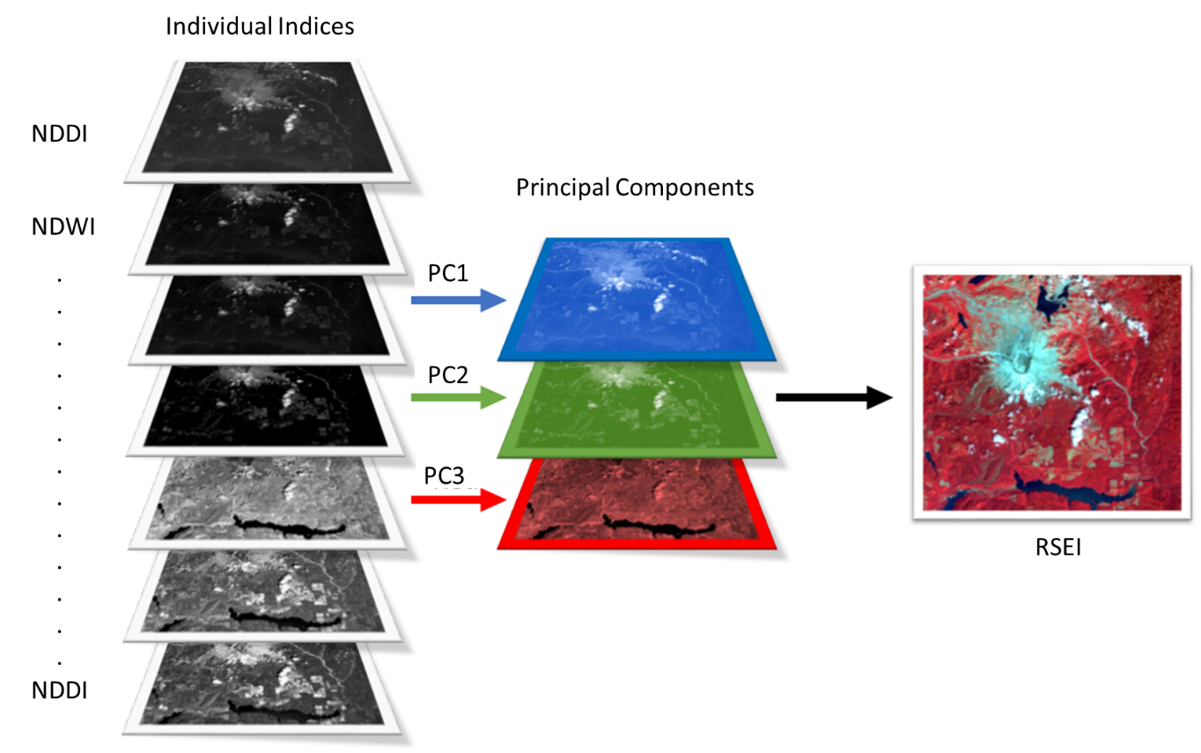
Principal Component Analysis
Introduction
Project formulation
Analysis
Results and discussions
Methodology
Spectral responses – influenced by dimensionality of image data
PCA ensures – all the surface materials unequivocally mapped in only one of the PC images
Captures essence of data in few PCs – convey most of the variation in dataset
NDMI

Slide 16
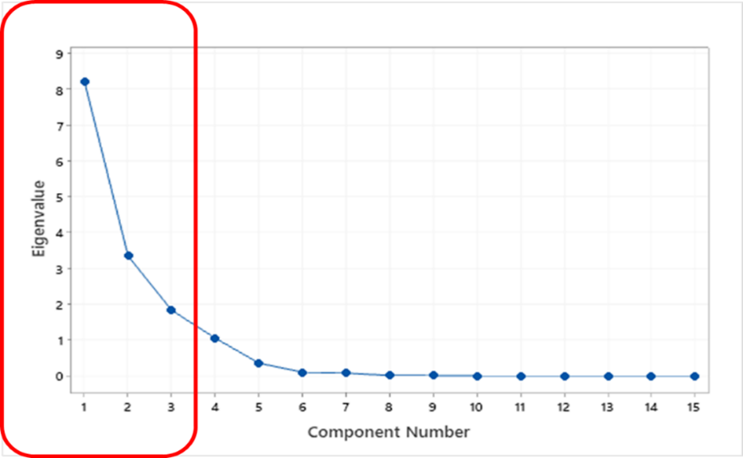
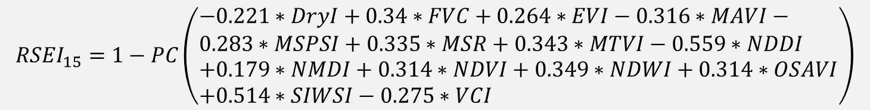
RSEI equation based on PCA
Introduction
Project formulation
Analysis
Results and discussions
Methodology
Eigen analysis of the correlation matrix
$$\begin{aligned}&{RSEI}_{15}=1−PC\left(\begin{aligned}&−0.221∗DryI+0.34∗FVC+0.264∗EVI−0.316∗MAVI− \\ &0.283∗MSPSI+0.335∗MSR+0.343∗MTVI−0.559∗NDDI \\ &+0.179∗NMDI+0.314∗NDVI+0.349∗NDWI+0.314∗OSAVI \\ &+0.514∗SIWSI−0.275∗VCI\end{aligned}\right)\#\end{aligned}$$

Slide 17
Model validation
Introduction
Project formulation
Analysis
Results and discussions
Methodology
Accuracy assessment of RSEI₁₅ against individual RS indices
The most desirable ecological conditions
Higher vegetation coverage
Higher soil-plant moisture
Less land surface dryness
As per PSR framework above ecological conditions leads to increased –
Crop production
RSEI₁₅ model assessed against individual indices over –
Historical crop production
Ahmednagar district

Slide 18
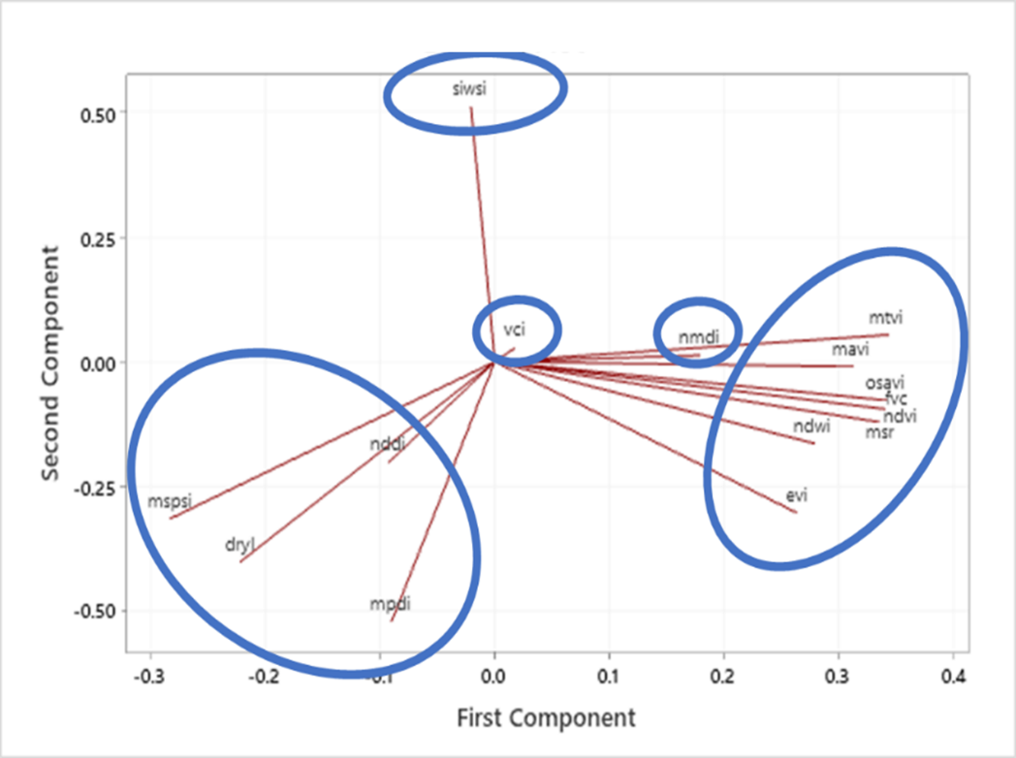
Model evaluation
Introduction
Project formulation
Analysis
Results and discussions
Methodology
RSEI₁₅ not highly effective than the individual RS indices
To identify issues –
PCA was analyzed
PCA accounts for varied influences of original characteristics
Influences tracked from PCA plot
PCA plot shows –
Clusters of RS indices based on similarity
Redundant multiple indices
Feature Selection based
Dimensionality Reduction

Slide 19
Dimensionality Reduction
Introduction
Project formulation
Analysis
Results and discussions
Methodology
To mitigate the problem of high dimensionality of data
DR techniques –
Feature extraction (PCA)
Feature selection
Feature selection –
Attributes tested for worthiness
Selection and elimination
E.g.
Low variance filter
High correlation filter
Pairwise correlation matrix for 15 remote sensing indices
Feature selection + feature extraction

Slide 20
Improved model (Reduced Models)
Introduction
Project formulation
Analysis
Results and discussions
Methodology
To mitigate the problem of high dimensionality of data
DR techniques –
Feature extraction (PCA)
Feature selection
Feature selection –
Attributes tested for worthiness
Selection and elimination
E.g.
Low variance filter
High correlation filter

Slide 21
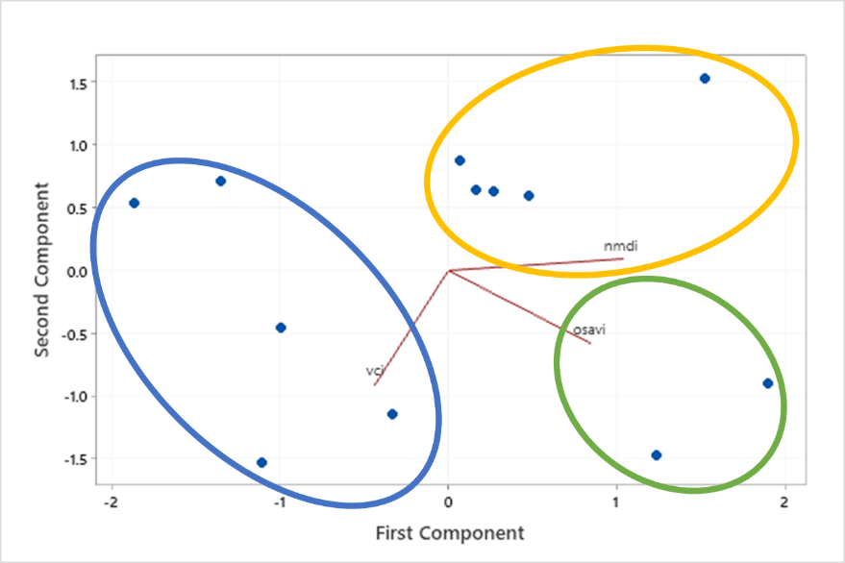
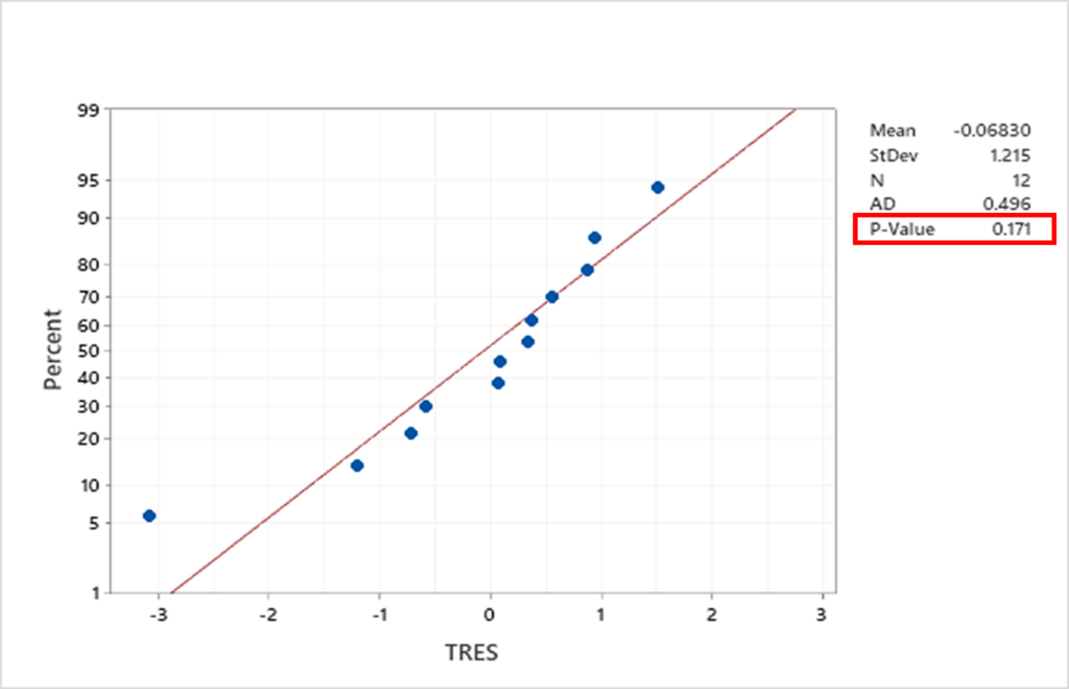
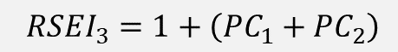
RSEI₃ model
Introduction
Project formulation
Analysis
Results and discussions
Methodology
$${RSEI}_{3}=1+\left({PC}_{1}+{PC}_{2}\right)$$
$$\begin{aligned}&{RSEI}_{3}=1+PC\left(0.648∗NMDI+0.665∗OSAVI−0.746∗VCI\right)\#\left(20\right)\end{aligned}$$
Normal probability plot of deleted residual of regression model (RSEI₃ – crop production)
✓
Eigen analysis of the correlation matrix

Slide 22
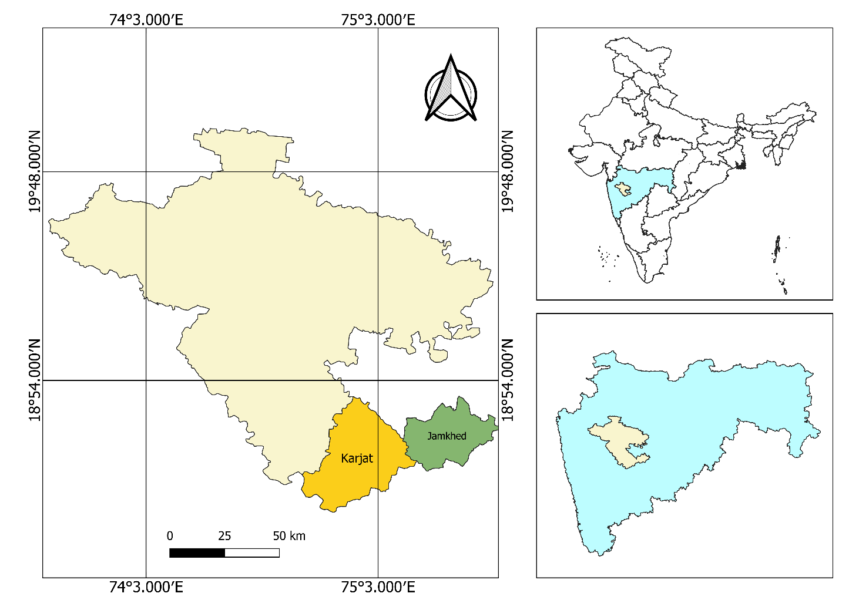
Comparative analysis of impact assessment by CAG and RSEI
Introduction
Project formulation
Analysis
Results and discussions
Methodology
GoM in 2014 – Jalyukta Shivar Abhiyan
State version of MGNREGS-IWMP
Maharashtra – drought free by 2019
Increase water availability
In 2020 CAG conducted an audit of these works in Maharashtra
Ahmednagar district – 2 talukas (Karjat and Jamkhed)
Ahmednagar district has third highest number of MGNREGS-IWMP projects from 2007-20 with outlay of Rs.2,700 crores
Karjat (orange) and Jamkhed (green) taluka in Ahmednagar (cream) district of Maharashtra state (blue) in India

Slide 23
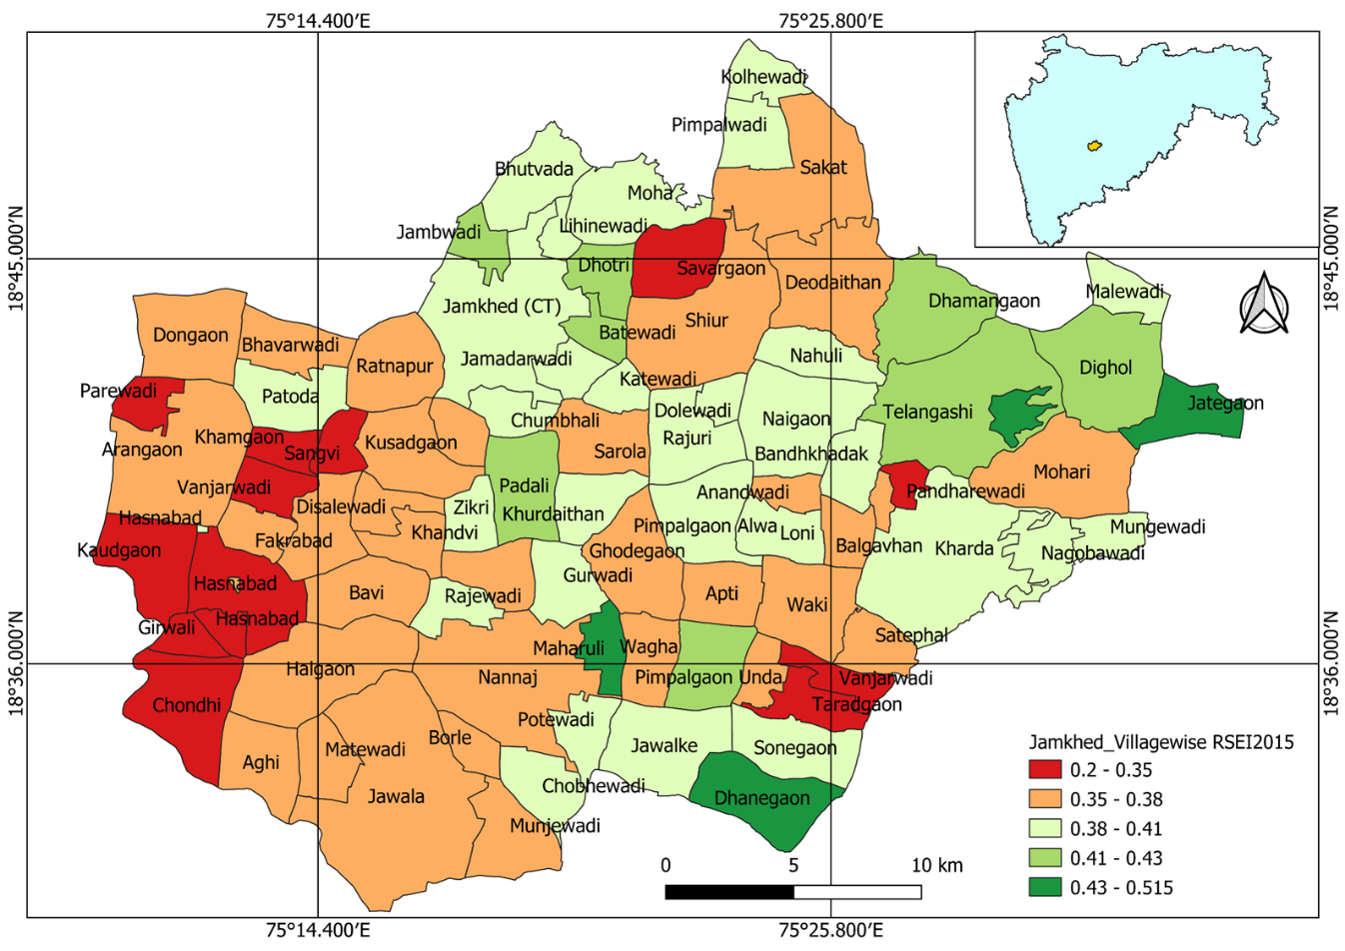
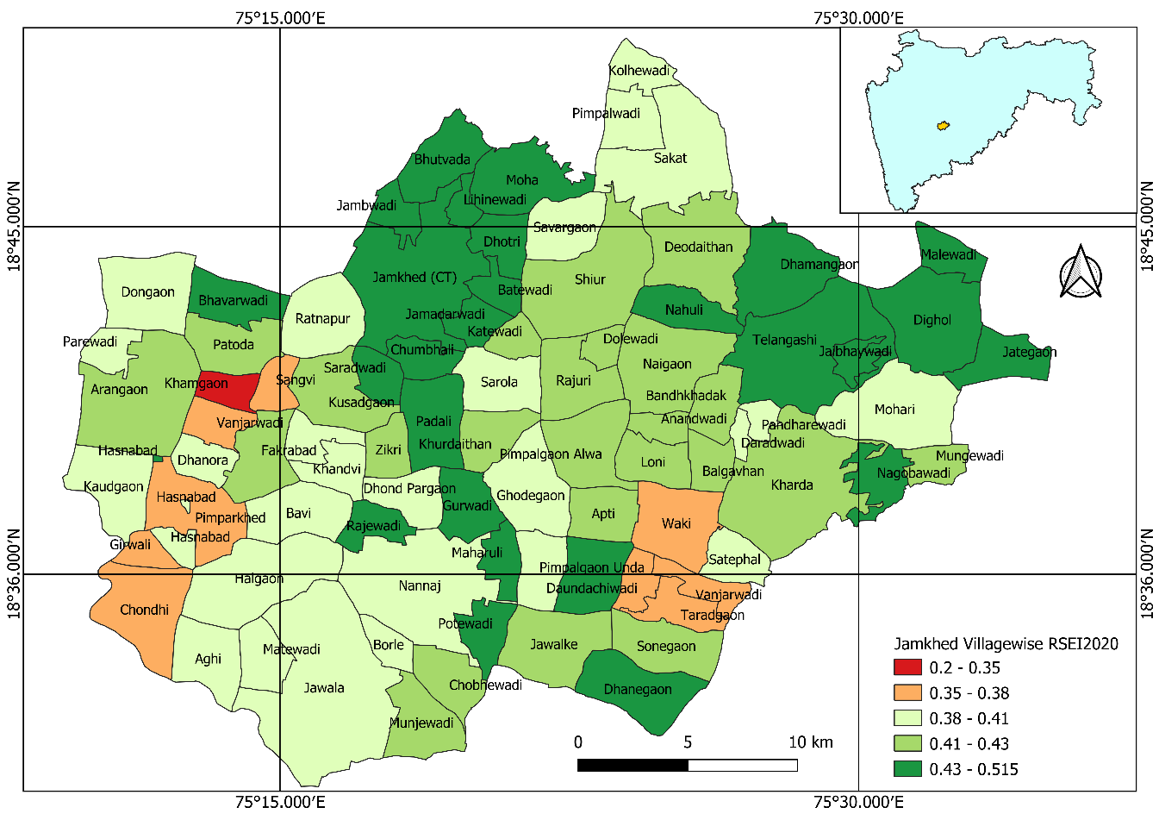
Village wise RSEI₃ in 2015 and 2020 for Jamkhed taluka
Introduction
Project formulation
Analysis
Results and discussions
Methodology
2015
2020

Slide 24
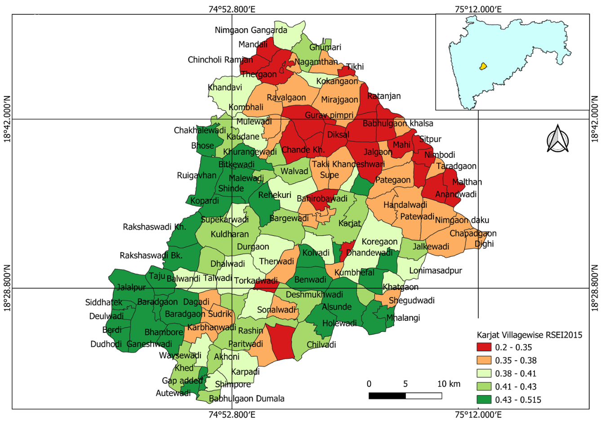
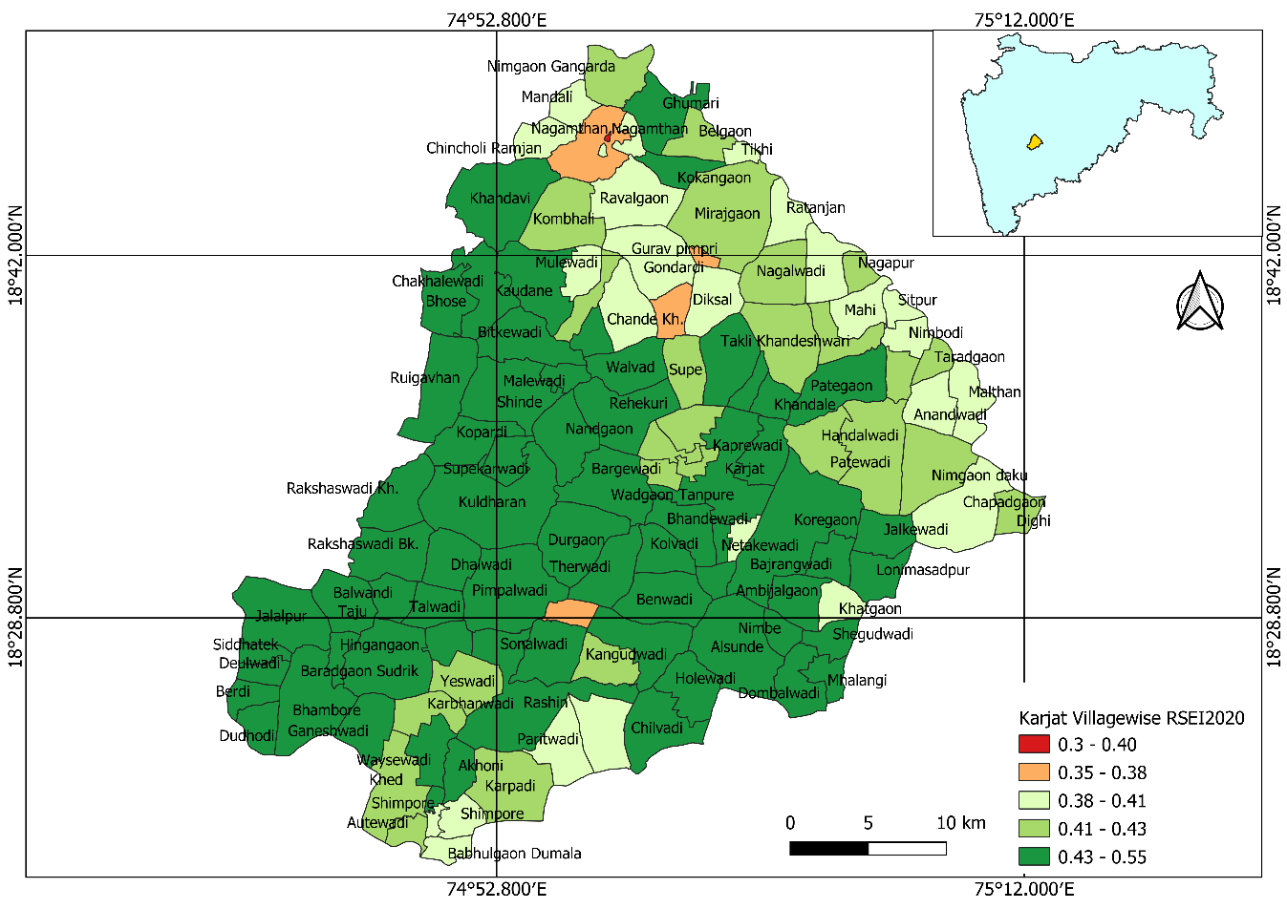
Village wise RSEI₃ in 2015 and 2020 for Karjat taluka
Introduction
Project formulation
Analysis
Results and discussions
Methodology
2015
2020

Slide 25
Results of comparative impact assessment
Introduction
Project formulation
Analysis
Results and discussions
Methodology
CAG found that 15 villages in two talukas of Ahmednagar district did not achieve the water neutrality from 2015 to 2020
Although the list of villages failing to achieve water neutrality was not given
RSEI₃ equips us to identify the villages having stressed vegetation, low soil moisture, and drought like conditions
The villages were –
Khamgaon, Sangvi, Vanjarwadi, Hasnabad, Pimparkhed, Girwali, Chondhi, Waki, and Ta-radgaon in Jamkhed taluka
Chande Kh., Nagamthan, Shimpore, Khed, and Torkadwadi in Karjat taluka

Slide 26
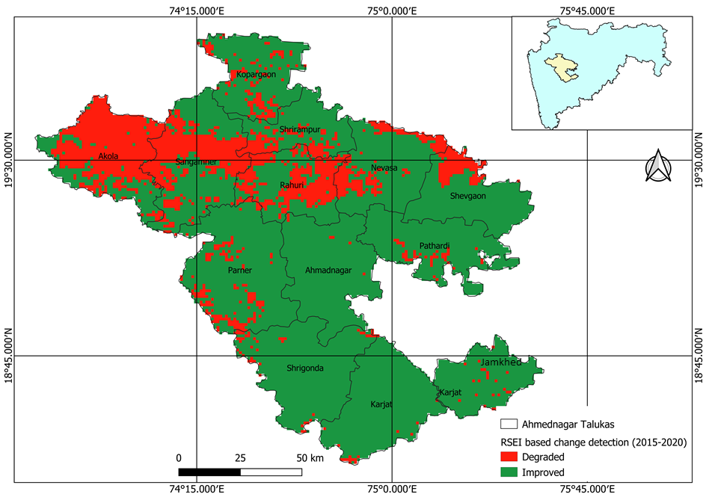
Impact assessment in Ahmednagar district using RSEI₃
Introduction
Project formulation
Analysis
Results and discussions
Methodology
RSEI based change detection map of Ahmednagar district 2015-20
Major talukas where the RSEI₃ has decreased from 2015 to 2020 instead of MGNREGS-IWMP projects are –
Akola, Sangamner, and Rahuri, with some parts of Shevgaon and Kopargaon.

Slide 27
Impact assessment on controlled vs. applied sites
Introduction
Project formulation
Analysis
Results and discussions
Methodology
Ecological status depends on agro-climatic conditions of a region
Delineated based on soil, water, temperature, rainfall conditions
Also the soil slope, soil texture, and soil drainage etc. influences the ecological status of land surfaces
Hence to ensure the fair comparison, regions with the same agro climatic conditions, and cropping patterns needs to be selected for study area
Ahmednagar district with one of the highest (20,028) works and Solapur with one of the lowest (2,800) works from 2007-20 have been selected for study areas which also shows the same agro-climatic and soil conditions

Slide 28
Productivity analysis of Ahmednagar and Solapur district
Introduction
Project formulation
Analysis
Results and discussions
Methodology
Productivity of Solapur district had an annual increase of 6% whereas
Ahmednagar district had an annual rise of 3%
Solapur district's productivity has increased at a higher pace of 3% than the Ahmednagar district
MGNREGS-IWMP projects have created no additional benefits in increasing the crop productivity of Ahmednagar district
Productivity of Solapur and Ahmednagar districts (Source: MGNREGS data portal)

Slide 29
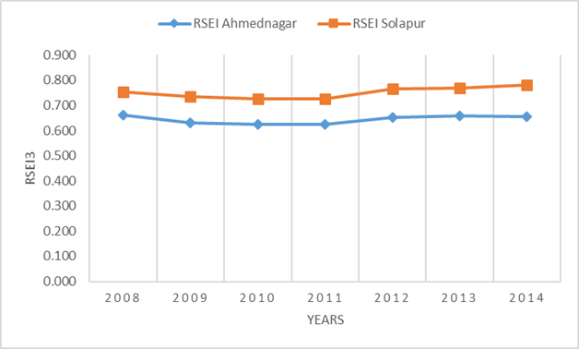
RSEI3 analysis of Ahmednagar and Solapur districts
Introduction
Project formulation
Analysis
Results and discussions
Methodology
Annual increase in the RSEI3 from 2008 to 2014 for Ahmednagar district was 4%
Whereas for Solapur district was 6%, i.e., 2% higher than the Ahmednagar district.
RSEI3 analysis supports results of productivity analysis which was 3% higher for the Solapur district
RSEI₃ for Solapur and Ahmednagar district for 2008 to 2014

Slide 30
Results and discussions
Introduction
Project formulation
Analysis
Results and discussions
Methodology
MGNREGS-IWMP assets have not additionally contributed
Towards increasing regional eco-logical status of land surfaces
Vis-à-vis crop production
As the controlled site is found to be performing better than the applied site with 20,028 works and Rs.2,700 crores of expenditure
The analysis questions the need, implementation, and effectiveness of MGNREGS-IWMP projects
The results needs to be further investigated with a detailed ground study so that the resources will be utilized in the right place, at the right time, and for the right cause.

Slide 31
Conclusion
Introduction
Project formulation
Analysis
Results and discussions
Methodology
The RSEI3 effective in monitoring the actual impacts of the MGNREGS-IWMP (WDC-PMKSY) projects
In improving the ecological status of the region
With an adjusted R-square value of 83% and Pearson correlation coefficient of 0.92.
RSEI framework also helps us to identify the areas with the poor performance of projects providing the data driven decision making and intervention design
The RSEI based on open source remote sensing big data has enabled
The near-real-time, comprehensive, robust, unbiased, and low-cost monitoring of the projects
A decision support system for decision-makers

Slide 32
Limitations and future directions
Introduction
Project formulation
Analysis
Results and discussions
Methodology
Needs ground-truthing data to further investigate the issues in the projects/assets created
Identify the spatial location of problematic project cases but does not comment anything about its causes
No one size fits all approach and –
Needs another study with another study area at larger scale at region/state/national level
Starting from RSEI₁₅ or higher version of model and truncate to different number of indicators

Slide 33
Thank you !!!

